Slide 1
METEOROLOGICAL DATA COLLECTION NETWORK OF IMD

Slide 2
Meteorological instrument Observer
Meteorological Observation
(In situ & Remote sensing)

Slide 3
Meteorological Variables Weather Forecasting Climate Study

Slide 4
1. Temperature 1.1 Air Temperature 1.2 Wet Bulb Temperature 1.3 Maximum Temperature 1.4 Minimum Temperature 1.5 Soil Temperature 1.6 Grass Minimum Temperature 1.7 Leaf Temperature 1.8 Sea Surface Temperature

Slide 5
2.Humidity 2.1 Dew Point Temperature 2.2 Relative Humidity 2.3 Vapour Pressure 3. Atmospheric Pressure 3.1 Station Level Pressure 3.2 MSL Pressure/Std. Level 3.3 Pressure Tendency

Slide 6
4. Cloud 4.1 Form 4.2 Amount 4.3 Direction 4.4 Height of Cloud Base 4.5 Height of Cloud Top

Slide 7
5. Wind 5.1 Speed 5.2 Direction 5.3 Gust 6. Precipitation 6.1 Amount 6.2 Depth of Snow 6.3 Thickness of Ice Accretion 6.4 Intensity

Slide 8
7. Radiation 7.1 Sunshine Duration 7.2 Solar Radiation 8. Visibility 8.1 Meteorological Optical Range (MOR) 8.2 Runway Visual Range (RVR)

Slide 9
9. Waves 9.1 Wave Height 9.2 Wave Period 9.3 Wave Direction

Slide 10
10. Evaporation 11. Soil Moisture 12. Present & Past Weather 13. Ozone Observation 14. Atmospheric Observation

Slide 11
OBSERVING SYSTEM 1. Manned Weather Station 2. Automatic Weather Station 3. Aeronautical Met. Station 4. Agro Meteorological Station 4.1 Evapotranspiration Observation 4.2 Soil Moisture Observation 4.3 Dew gauge Observation

Slide 12
5. Upper Air Observation 5.1 Pilot Balloon Observation 5.2 Radiosonde Observation 5.3 Radiowind Observation 5.4 Dropsonde Observation 5.5 Aircraft Observation 5.6 Rocket Observation

Slide 13
6. Marine Observation 7. Profiler Station 7.1 RADAR (RAdio Detection And Ranging) 7.2 LIDAR (LIght Detection And Ranging) 7.3 SODAR (SOund Detection And Ranging) 7.4 RASS (Radio Acoustic Sounding System) 7.5 Wind Profiler

Slide 14
8. Atmospheric Observation 9. Urban Observation 10.Road Observation 11.Satellite Observation

Slide 15
INSTRUMENTS
Measurement of Meteorological variable for Weather analysis, forecast & warning, weather dependent operation and climate study

Slide 16
SURFACE OBSERVATORY

Slide 17
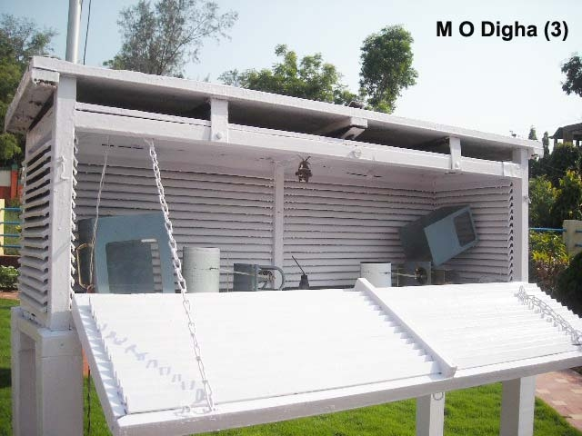
THERMOMETER & STEVENSON SCREEN
SSS DSS

Slide 18
KEW PATTERN BAROMETER

Slide 19
WIND VANE measures wind direction

Slide 20
ANEMOMETER measures wind speed

Slide 21
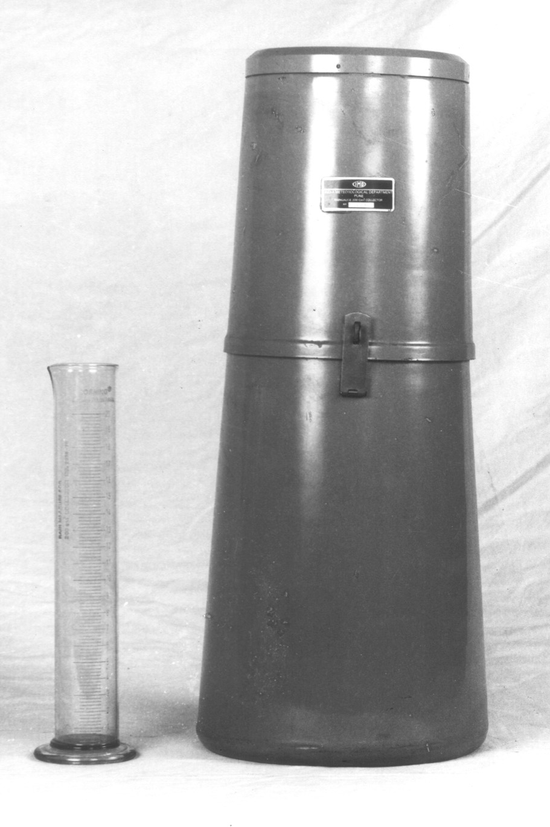
Ordinary Rain Gauge (ORG)

Slide 22
SNOW GAUGE
A snow gauge is a type of instrument used by meteorologists to gather and measure the amount of solid precipitation. The depth of snow is normally measured in centimeters, the measurement of melted snow (water equivalent) is in millimeters.

Slide 23
SELF RECORDING RAIN GAUGE
Obtain continuous record of rainfall

Slide 24
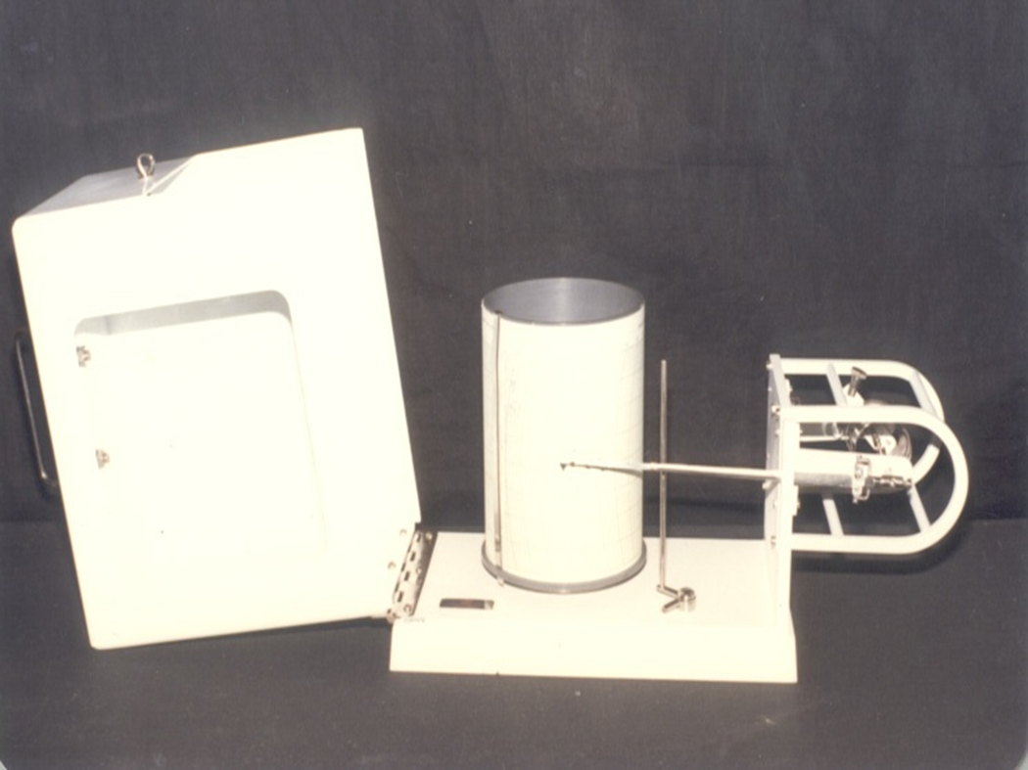
Thermograph
A thermograph gives a continuous record of the temperature of the air.

Slide 25
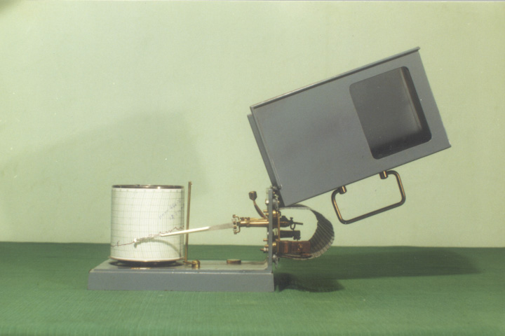
Hair Hygrograph
The hair hygrograph is an instrument used for recording continuously the relative humidity of the air.

Slide 26
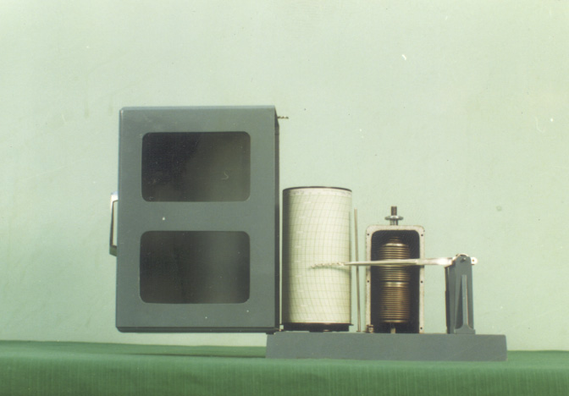
Barograph
Barograph is an instrument for the continuous recording of atmospheric pressure.

Slide 27
ANEROID BAROMETER

Slide 28
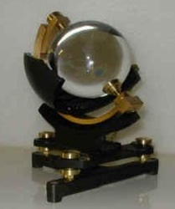
SUNSHINE RECORDER
Records hours of bright sun shine

Slide 29
AUTOMATIC WEATHER STATION

Slide 30
RADIATION INSTRUMENTS

Slide 31
DISDROMETER
A disdrometer is an instrument used to measure the drop size distribution and velocity of falling hydrometeors. The latest disdrometers employ microwave or laser technologies. 2D video disdrometers can be used to analyze individual snowflakes.

Slide 32
Present Weather Sensor

Slide 33
CEILOMETER
A ceilometer is a device that uses a laser or other light source to determine the height of a cloud base. Ceilometers can also be used to measure the aerosol concentration within the atmosphere.

Slide 34
RUNWAY VISIBLE RANGE

Slide 35
LYSIMETER

Slide 36
OPEN PAN EVAPORIMETER

Slide 37
BUOY OBSERVATION

Slide 38
SHIP OBSERVATION

Slide 39
Sea Surface Temperature

Slide 40
RADAR
Prediction of Cyclone, Thunderstorm, Hailstorm, Tornado, Rainfall, Wind etc.

Slide 41
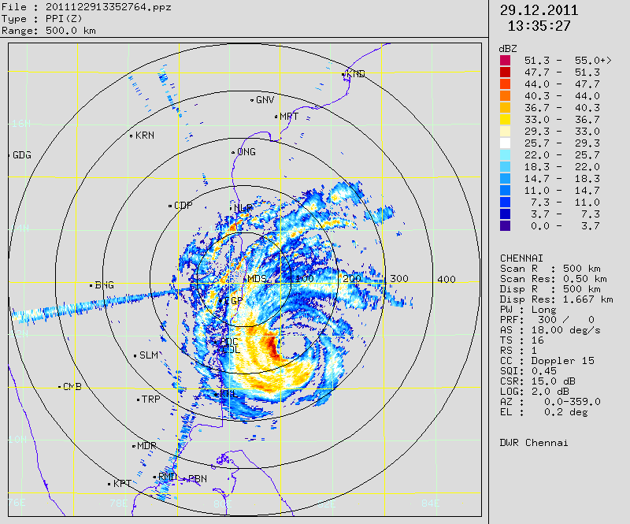
Radar Picture

Slide 42
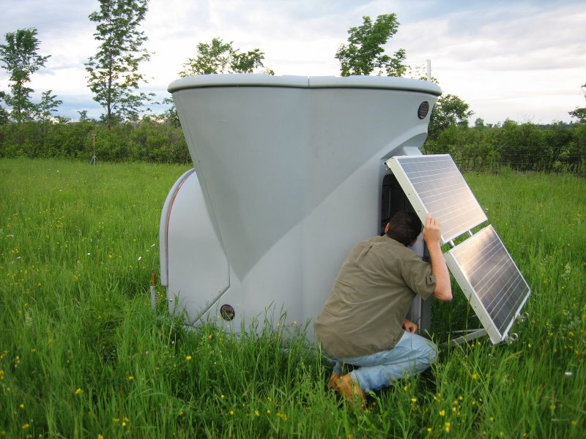
SODAR
SODAR remotely measures turbulence and wind profile

Slide 43
Radio Acoustic Sounding System
A radio acoustic sounding system (RASS) is a system for measuring the atmospheric lapse rate using backscattering of radio waves from an acoustic wave front to measure the speed of sound at various heights above the ground.

Slide 44
SPECTROPHOTOMETER
Dobson spectrophotometers can be used to measure both total column ozone and profiles of ozone in the atmosphere

Slide 45
SATELLITE
INSAT-3D

Slide 46
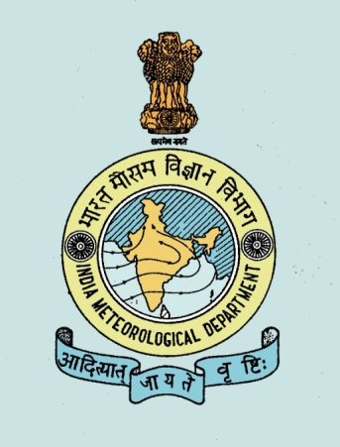
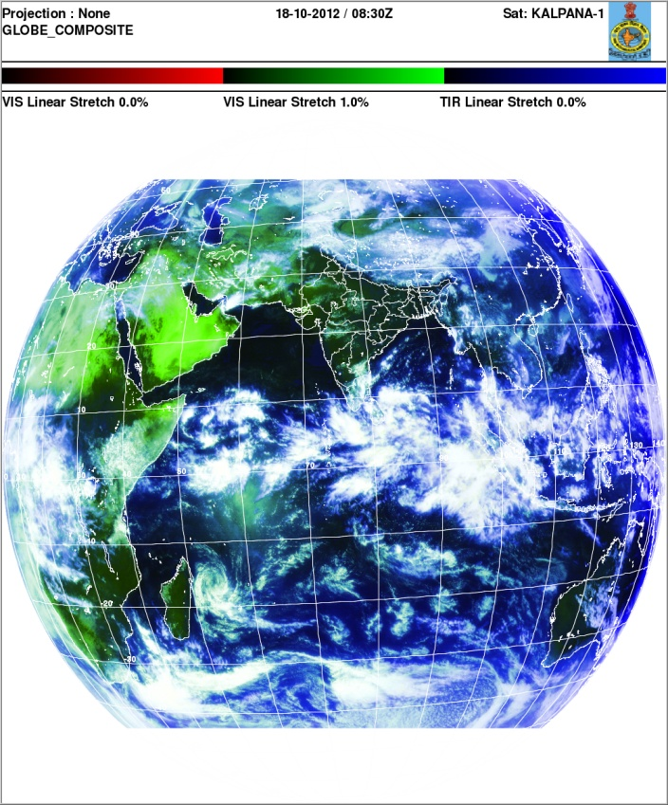
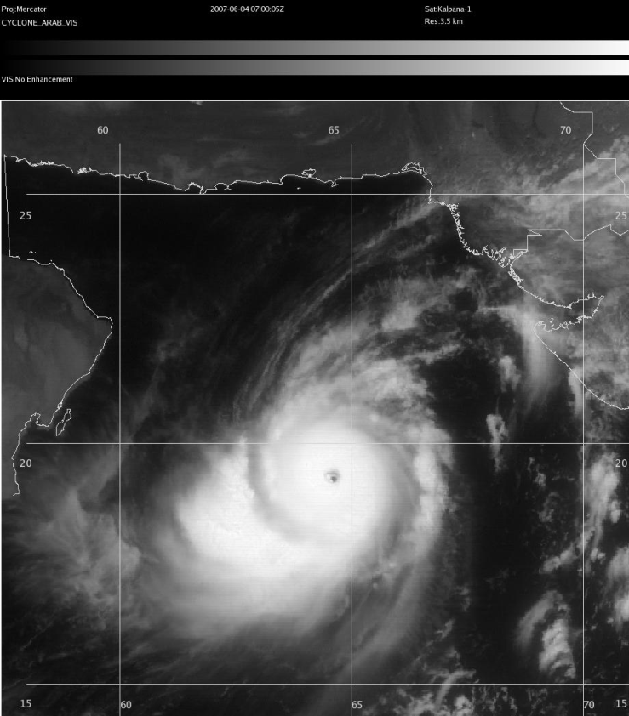
Satellite Meteorology

Slide 47
SATELLITE PRODUCTS
INSAT 3D HAS 6-CHANNEL IMAGER
& 19-CHANNEL SOUNDER
PRODUCT
Normalized Differential Vegetative Index (NDVI)
Outgoing Long wave Radiation(OLR)
QPF,SST,AMV,H-E
Water Vapor Wind Vector

Slide 48
SATELLITE PRODUCTS
Lifted Index
Cyclone Position & Intensity
Vertical profile of Temp. & Humidity
Stability Indices
Total Precipitable Water
Total Column Ozone
Cloud Motion Vector(CMV)
Cloud Top Temperature(CTT)

Slide 49
NETWORK of IMD
SURFACE OBSY 440
RSRW 39
PBO 62
AWS 691
ARG 746
AERONAUTICAL 71
RADAR 29

Slide 50
NETWORK of IMD
AGROMET 130
SEISMO 55
TSUNAMI WARNING 17
ATMOSPHERIC 11
OZONE 4
RADIATION 45
NON-DEPT RG 8579

Slide 51
Thank You
imd.gov.in
imdaws.gov.in

